Slide 1
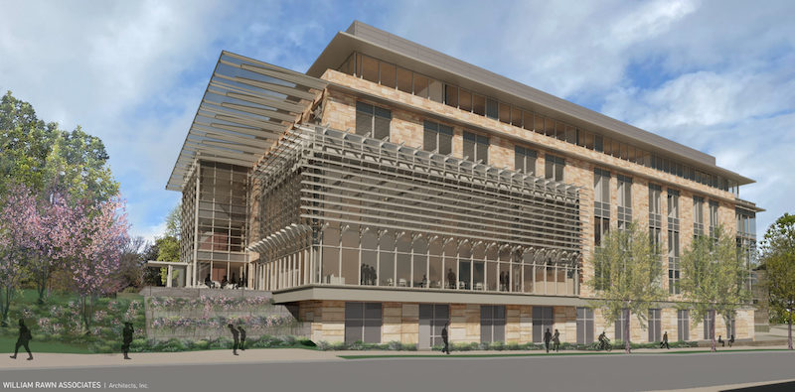
THE FOUNDATION
WEEK 2

Slide 2
WHY FOUNDATIONS MATTER
CLARITY BEFORE TACTICS
WEEK 2 OUTCOMES
Build the brand, customer, journey, and goal foundations for a stronger digital marketing strategy.
Identify what must be defined before strategy begins
Connect customer insight to channel choices
Select goals that fit the organization and market

Slide 3
WEEK 2 ROADMAP
1. THE FOUNDATION
Brand, customer, and goals
2. THE BRAND
Mission, positioning, identity, and image
3. THE CUSTOMER
Buyer persona, journey, and touchpoints
4. CAMPAIGN GOALS
Choose the right outcome before the tactics
THE FOUR SECTIONS
FOUNDATION
BRAND
GOALS
CUSTOMER

Slide 4
SECTION 1 — THE FOUNDATION
Strong digital strategy starts with clarity about the brand, the customer, and the goal.

Slide 5
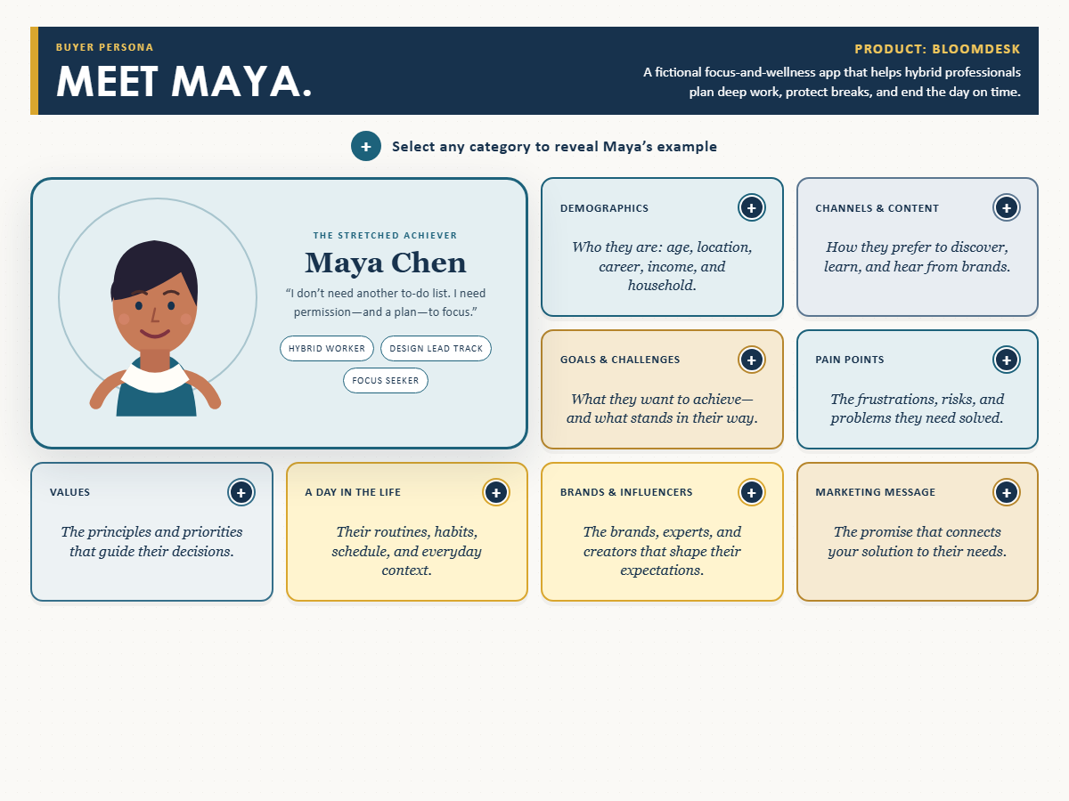
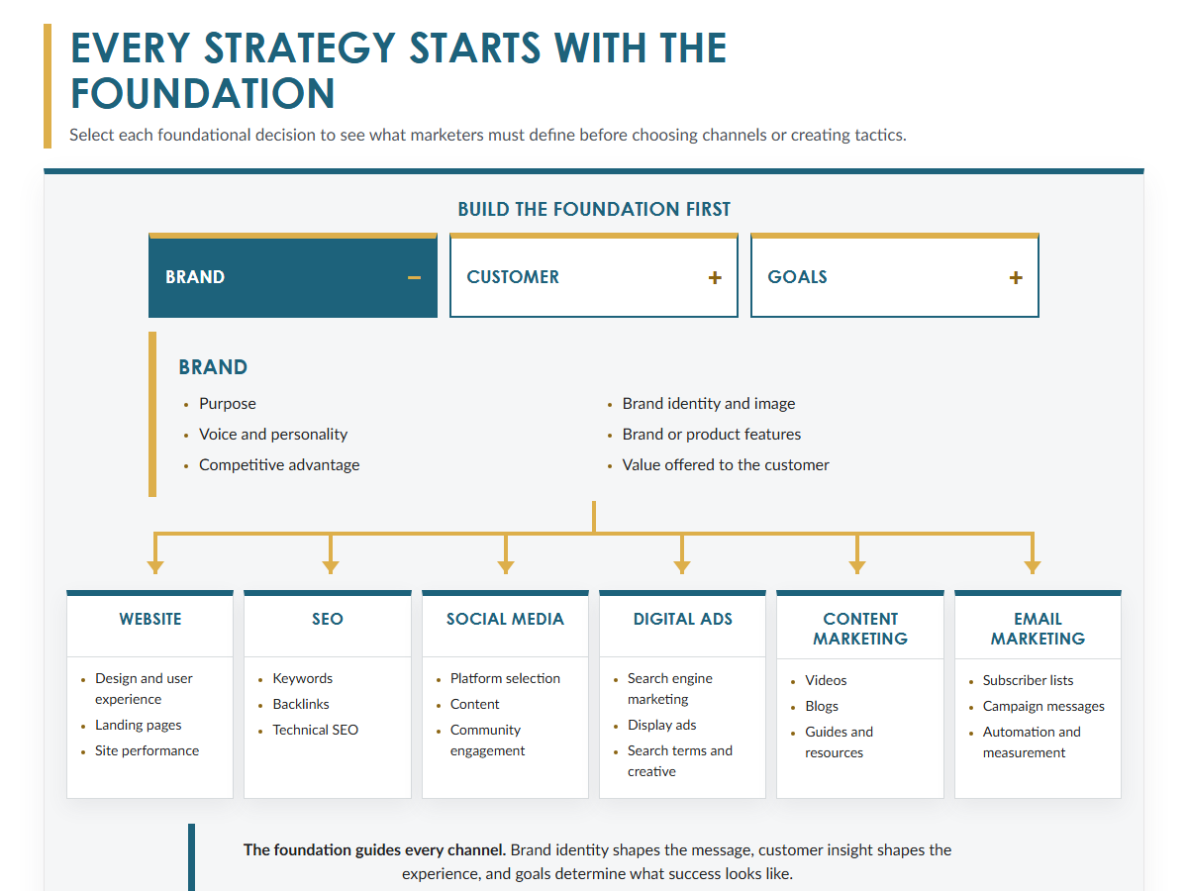
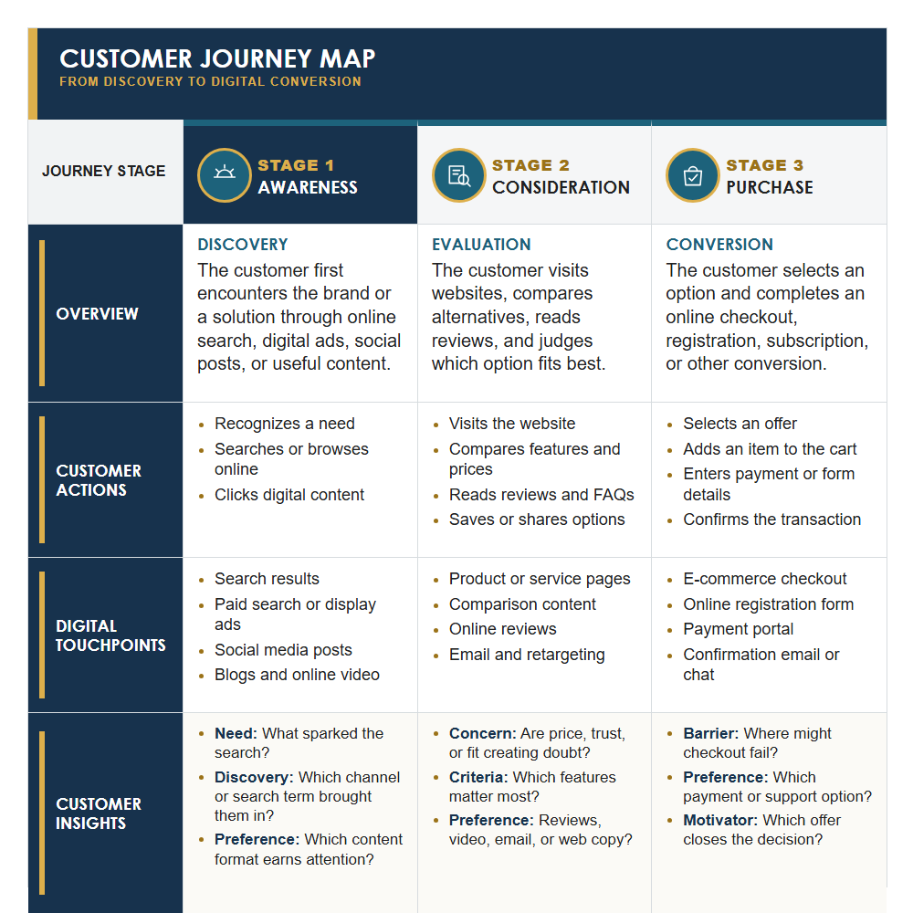
THE FOUNDATION
Before choosing tactics, define:
What the organization stands for
Who the customer is
What the campaign must accomplish

Slide 6
ONE FOUNDATION
MANY CHANNELS
CONSISTENT STRATEGY
These decisions shape every execution:
Website and landing pages
SEO and content
Social media and digital ads
Email marketing

Slide 7
SECTION 2 — THE BRAND
Purpose, position, and identity give the brand a clear place in the customer’s mind.

Slide 8
MISSION
PURPOSE
DIRECTION
A mission statement explains why the organization exists and what it seeks to contribute.
It guides content, messaging, and decisions so the brand communicates with one voice.

Slide 9
POSITIONING STATEMENT
For [target audience], [product or service] is [concise description]. It is ideal for [best use or application] because [primary benefit or differentiation].

Slide 10
UNIQUE SELLING PROPOSITION
State the compelling benefit in language the customer immediately understands.

Slide 11
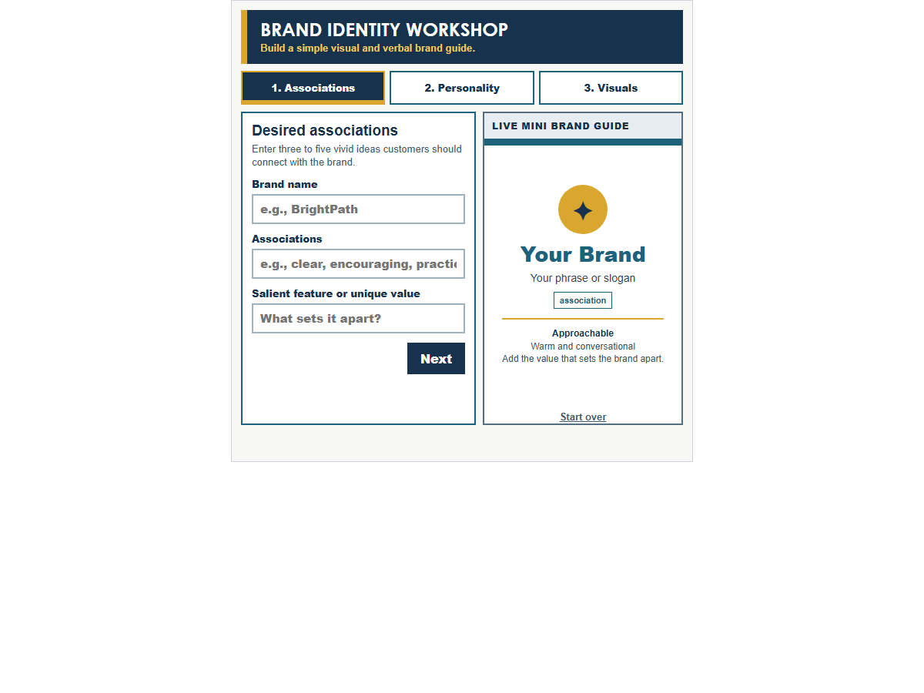
BRAND IDENTITY
Identity is what the company intentionally creates.
Image is what people actually believe.
Associations are the ideas, qualities, feelings, images, and experiences people connect to the brand.

Slide 12
SECTION 3 — THE CUSTOMER
Turn target-market research into a vivid buyer persona and a mapped path to purchase.

Slide 13
BUYER PERSONA
A semi-fictional portrait of the ideal customer, grounded in research.
Include demographics, lifestyle, pain points, objections, media habits, search behavior, and a day in the life.

Slide 14
CUSTOMER JOURNEY

Slide 15
JOURNEY MAP

Slide 16
SECTION 4 — CAMPAIGN GOALS
Choose the desired outcome first. Tactics come after the goal is clear.

Slide 17
AWARENESS
ACTION
RELATIONSHIP
Campaign goals describe outcomes—not channels.
Awareness and recall
Sales, traffic, and leads
Positioning and credibility
Relationships and value

Slide 18
THE FOUNDATION
Brand clarity + customer insight + the right goal create a strategy that can guide every channel and tactic.

